Slide 1
Master of Science:
Applied Data Science
Portfolio
Anthony (Ollie) Olivieri

Slide 2
Whitman School of Management
Statistics
Population, sampling, distribution, variance
Hypothesis testing, confidence, statistical significance
Correlation, Chi-Square
Regression linear, non-linear, logistic
Business applications
DMAIC, Kappa repeatability
Optimization of investment, labor hours, resources
Focus
Marketing, clustering, conjoint analysis
1

Slide 3
School of Information Studies
Programming
R, Python, SQL, NoSQL, Spark, Jupyter, Numpy, Pandas, Scikit Learn
Techniques
Data mining, visualization, transformation, normalization
Train / test sampling, test statistics
Encoding, tokenization
Hyperparameter optimization, cross-validation, forward-validation
Regression / Classification / Time-series
Linear, Random Forest, Neural Net
Multinomial Naive Bayes, Support Vector Machines
ARIMA, Prophet
Business applications, information security
Structured and unstructured data, JSON, XML, records, text
2

Slide 4
Partial List of Data Sources
Structured Records
Western PA Regional Data
http://www.wprdc.org/
Census Bureau Fact Finder
https://factfinder.census.gov/faces/nav/jsf/pages/index.xhtml
XML
Zillow API
https://www.zillow.com/howto/api/APIOverview.htm
Combination Structured / Unstructured
Pittsburgh Crime Data
http://pittsburghpa.gov/publicsafety/violence-dashboards/crime-data.html
Kaggle Tripadvisor
https://www.kaggle.com/damienbeneschi/krakow-ta-restaurans-data-raw
JSON
Twitter API
https://developer.twitter.com/en/docs.html
Collecting
Data
3

Slide 5
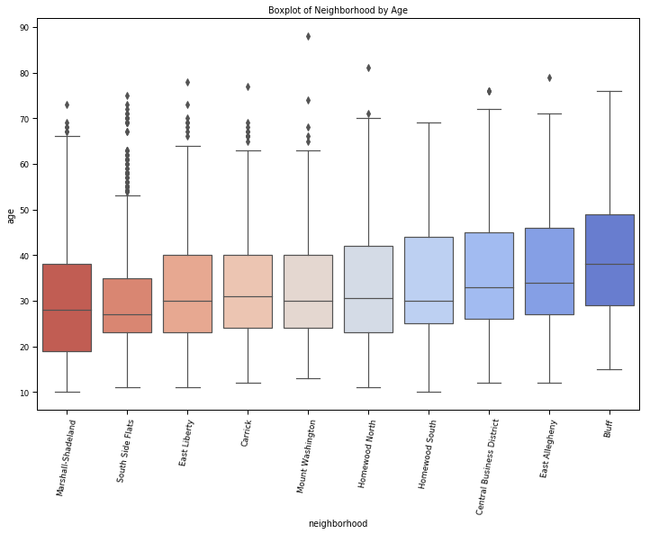
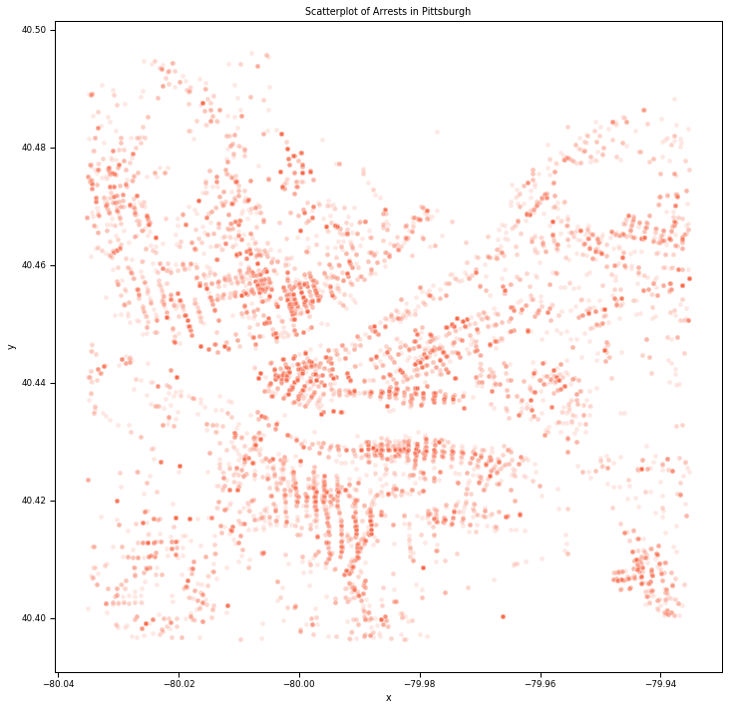
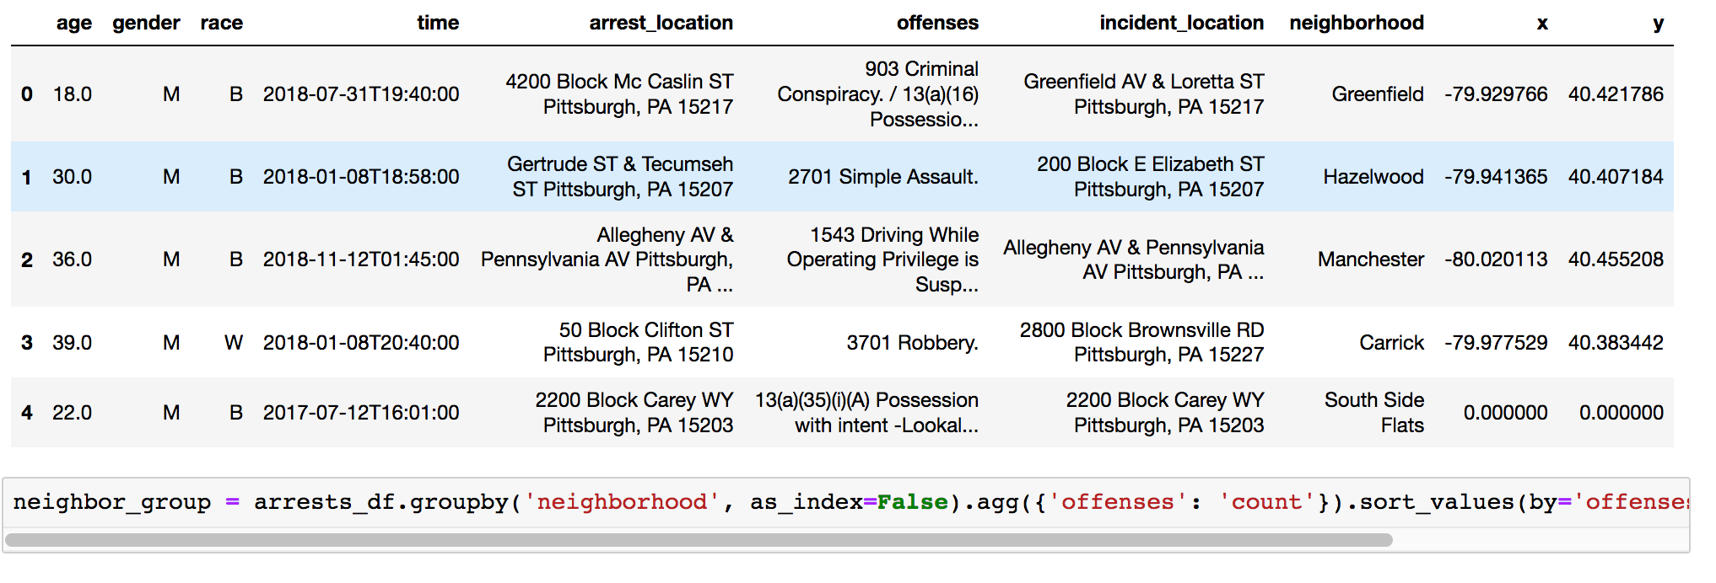
Organizing
Data
4

Slide 6
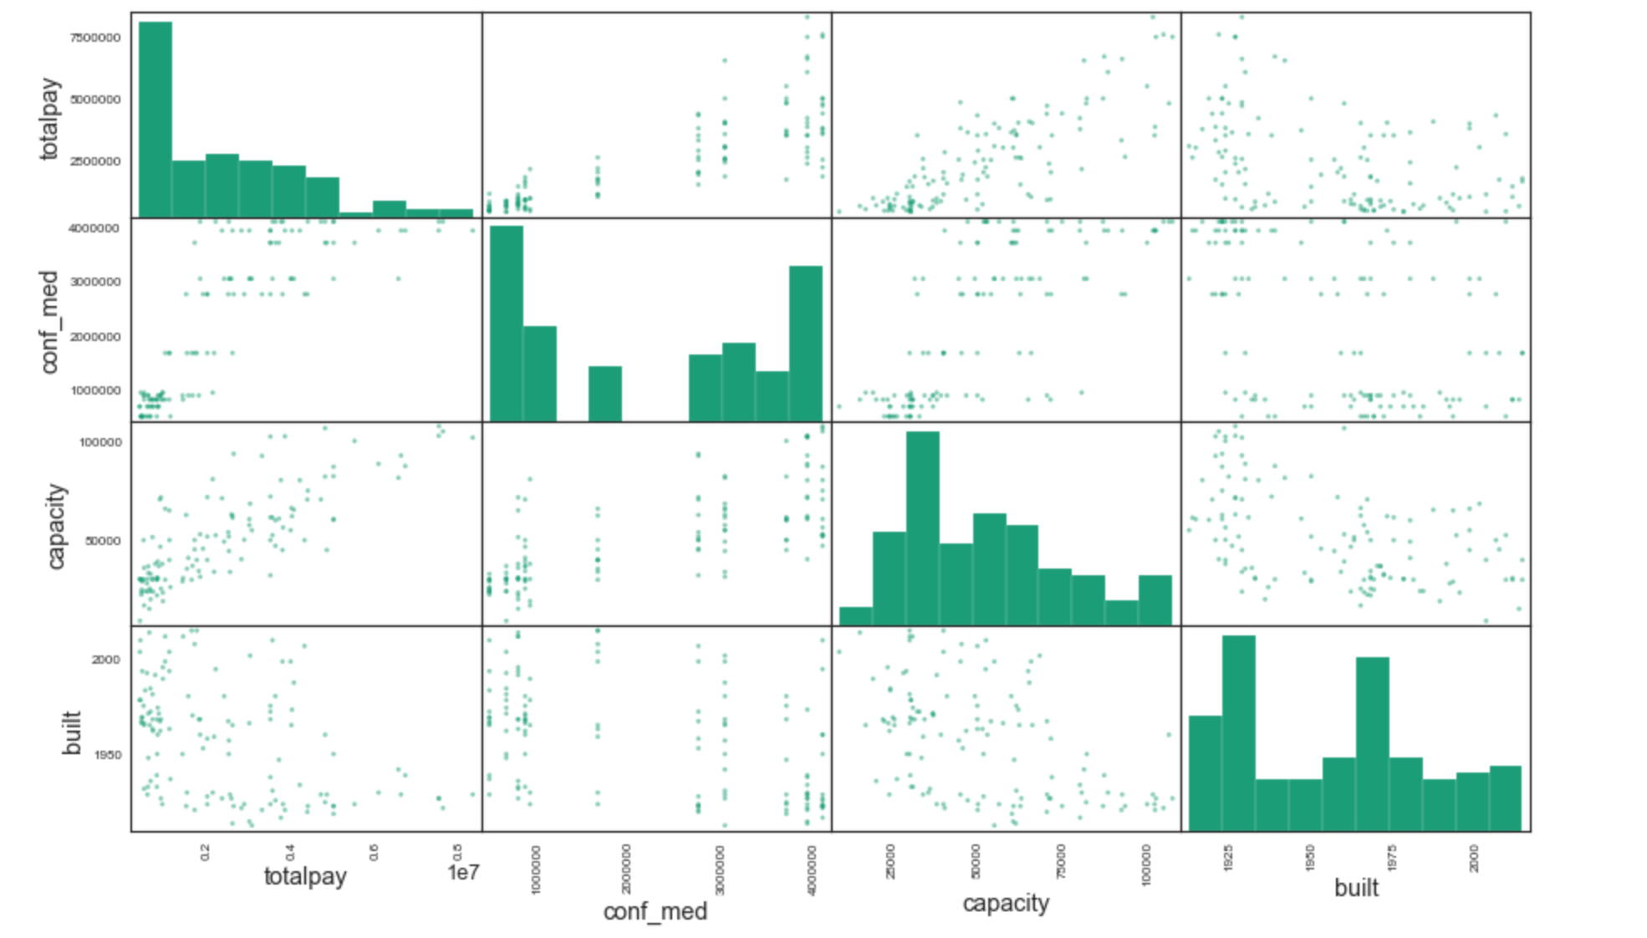
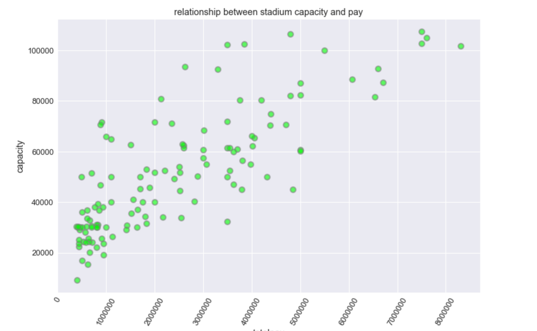
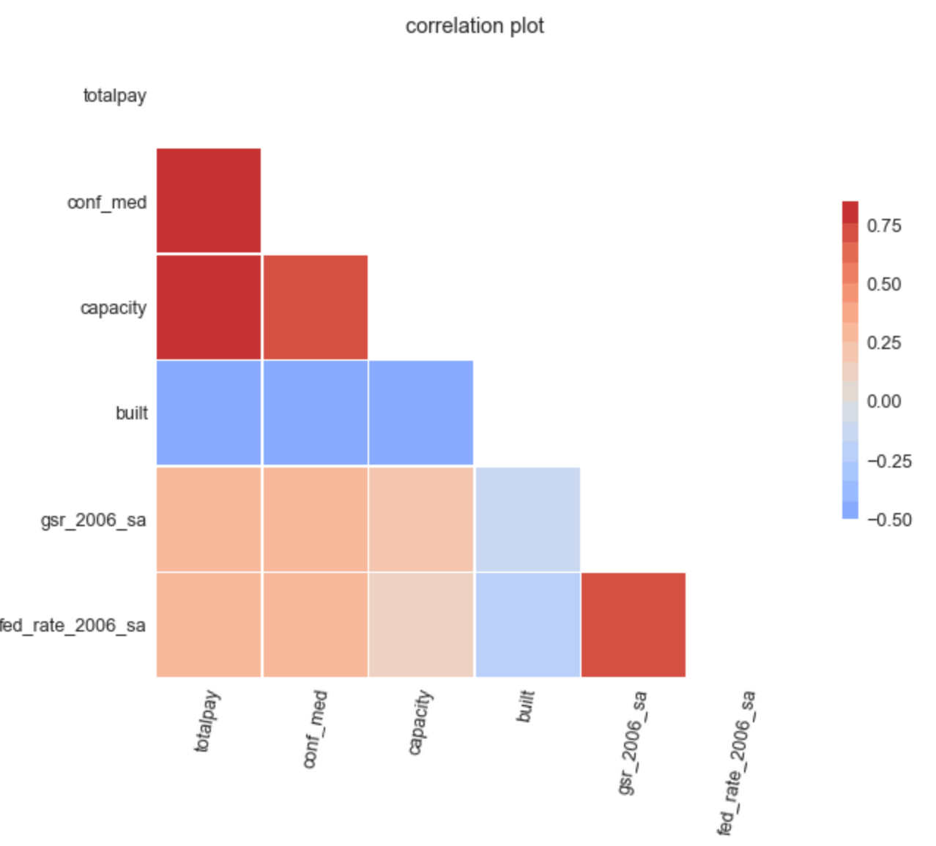
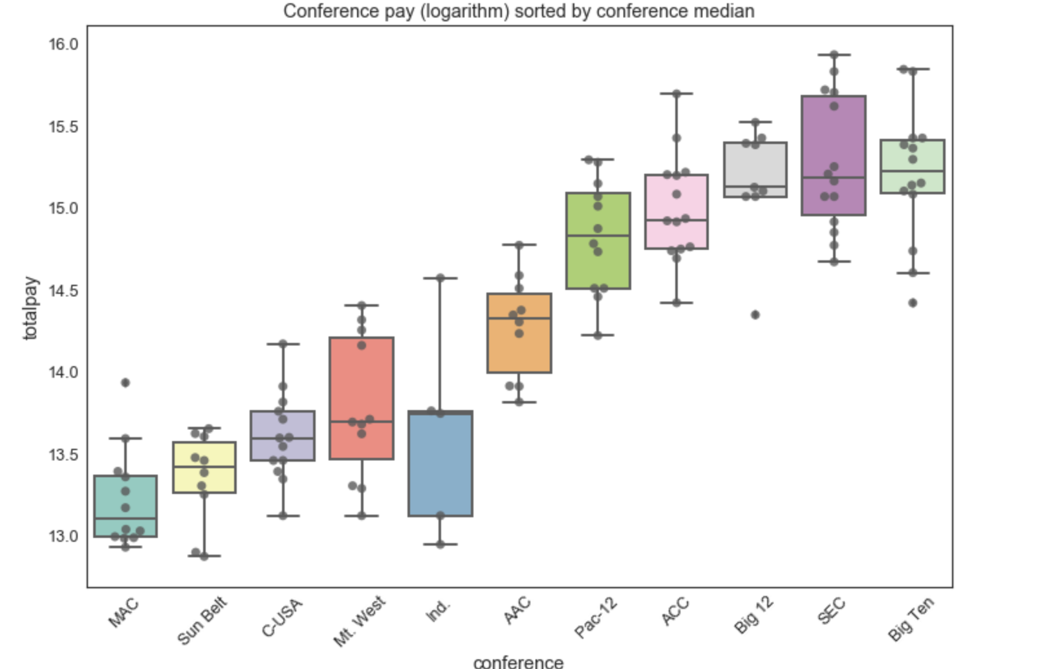
Analysis,
Visualization,
Data Mining
5

Slide 7
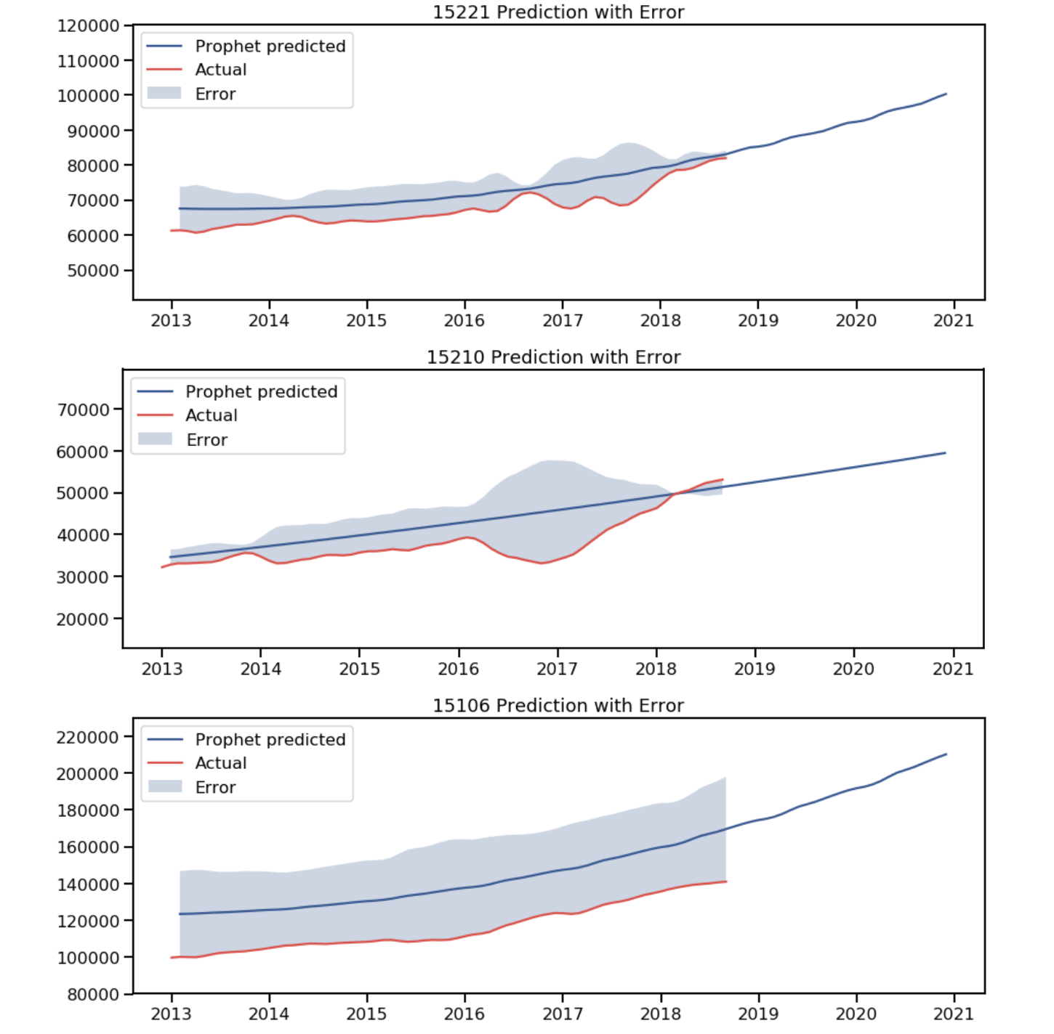
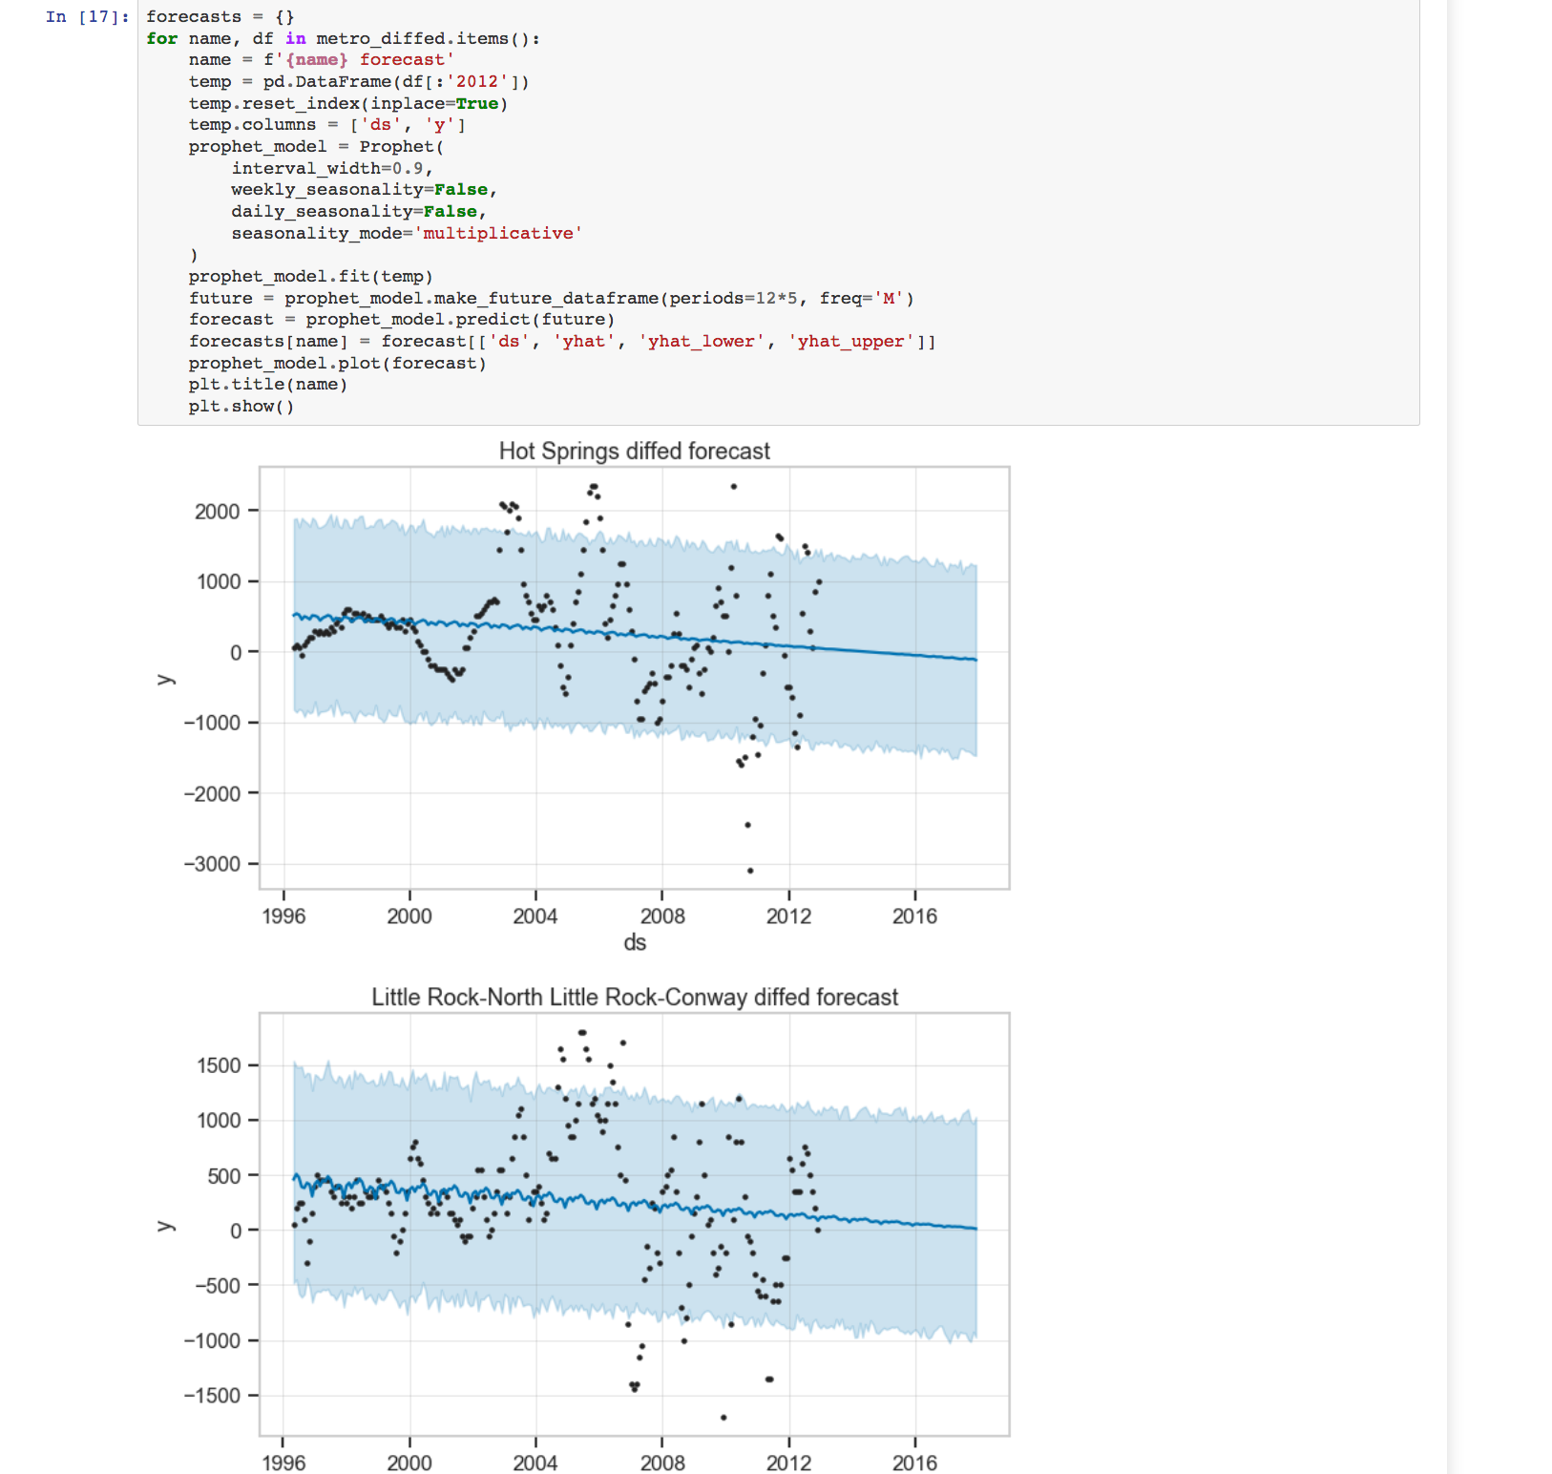
Business Recommendations
6
Notes:
Person 1-- Erin

Slide 8
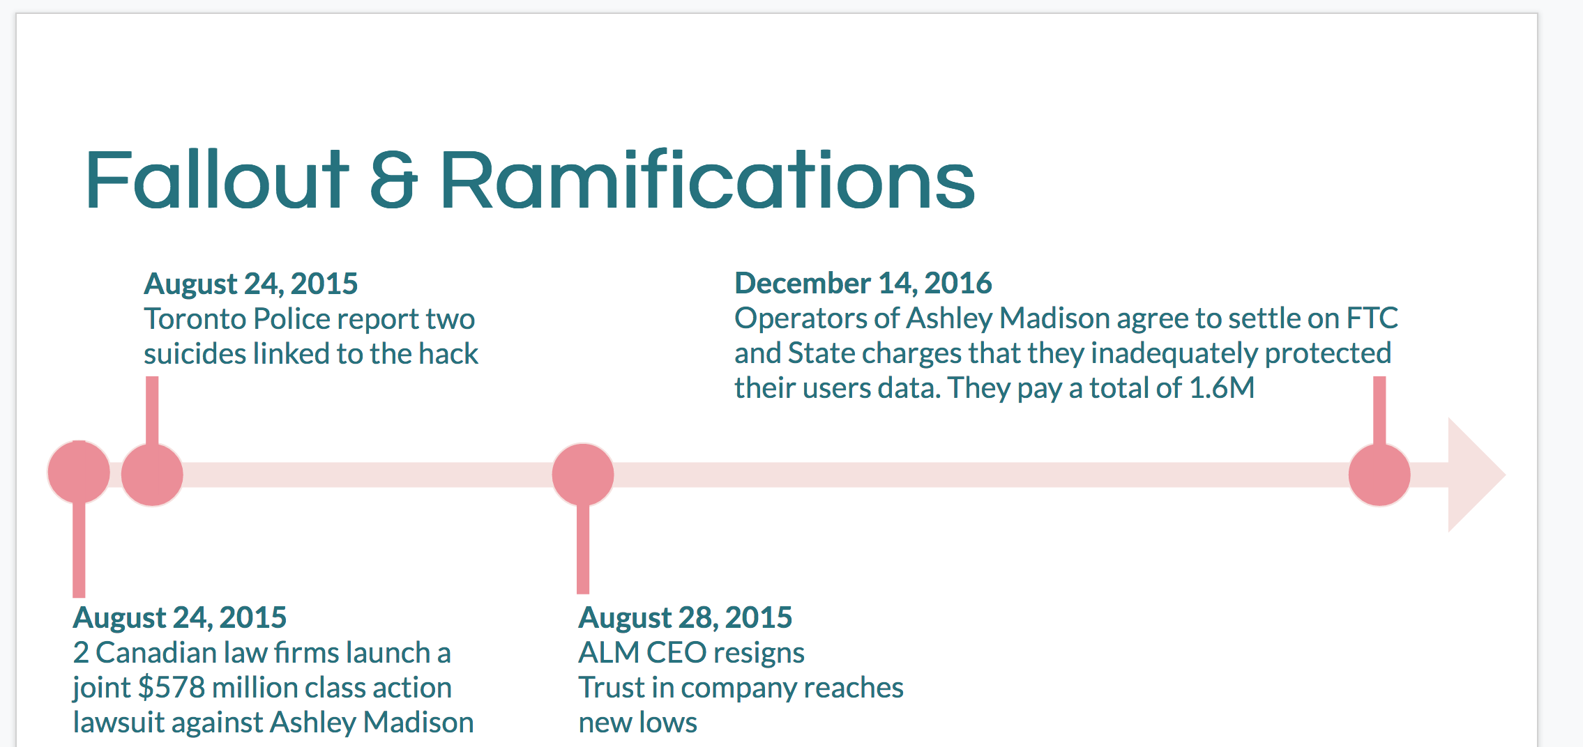
Information Security
7
Notes:
Person 1-- Erin

Slide 9
Next Steps
Focus on machine learning and big data technologies
MIT Linear Algebra Open Course
https://ocw.mit.edu/courses/mathematics/18-06-linear-algebra-spring-2010/
Amazon Web Services Cloud and Big Data Training
https://www.aws.training/LearningLibrary
Job interviews so far
Aspinity
CBS Interactive
Innovu
Argo Self-Driving Vehicle
Job interview to come
Accenture
Caterpillar
Notes:
Person 1-- Erin

